Slide 1



Network Sharing Sessions Chapter 1 : Head Office Network Mitra Transaksi Indonesia

Slide 2
Overview
HQ Network Diagram
Yokke HQ Network Flow
Conclusion

Slide 3
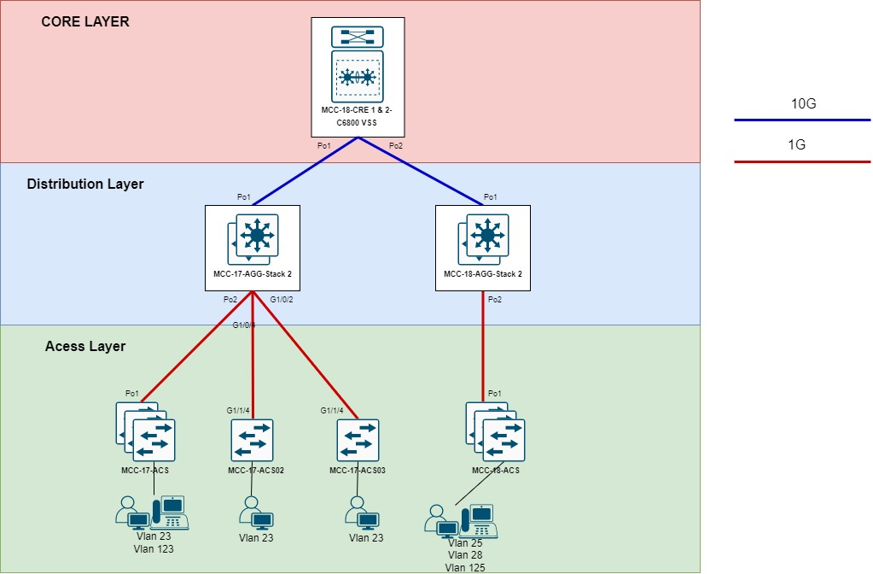
Yokke HQ Network Diagram

Slide 4
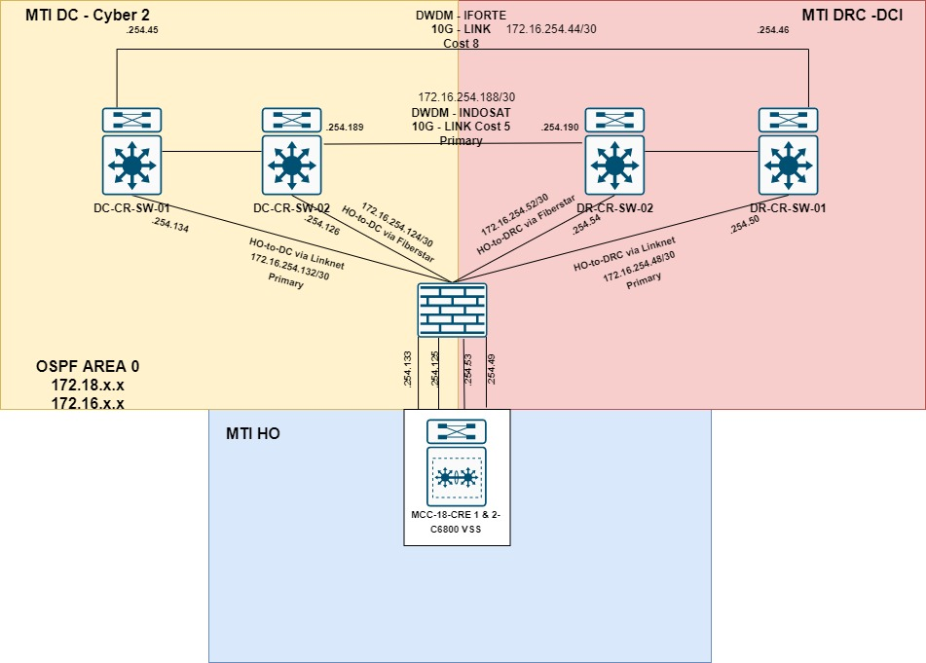
Triangle HO DC-DRC

Slide 5
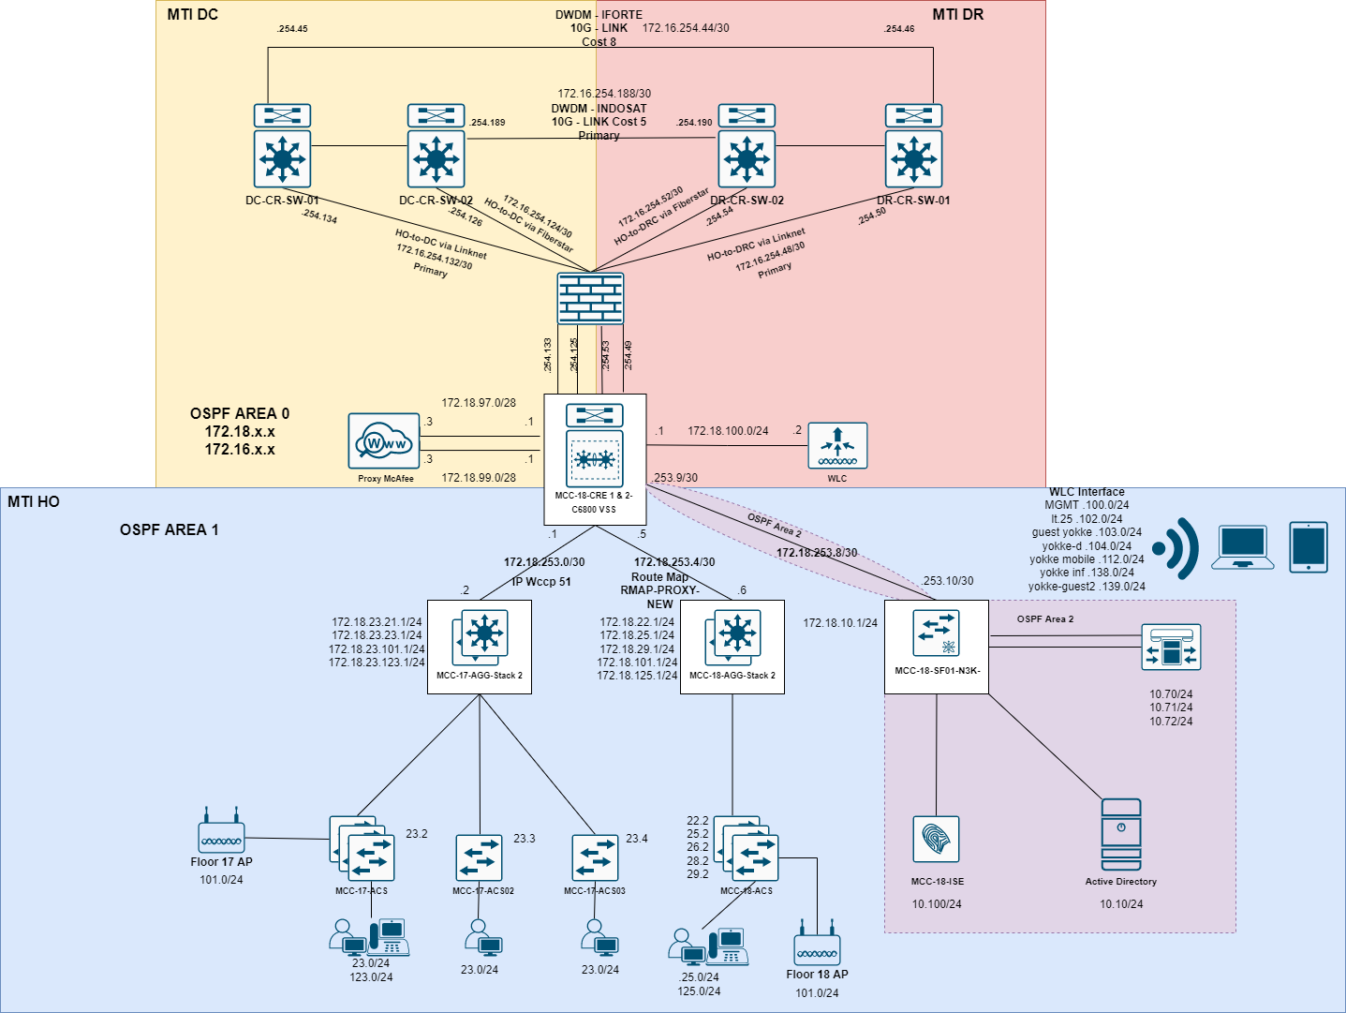
Yokke HO Network Operation Flow

Slide 6
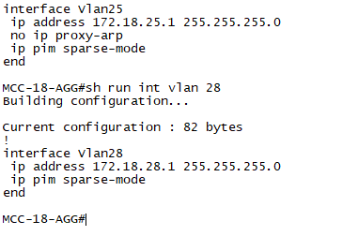
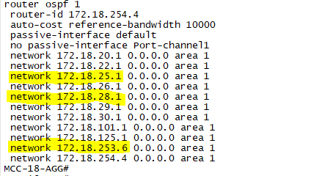
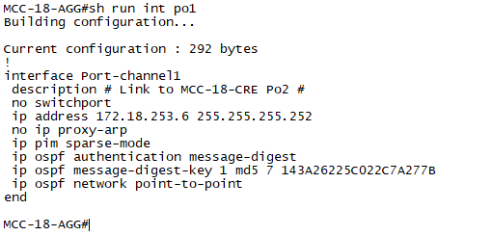
18th Floor Network Breakdown

Slide 7
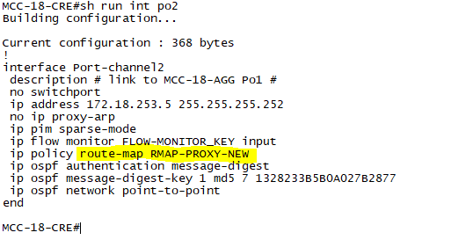
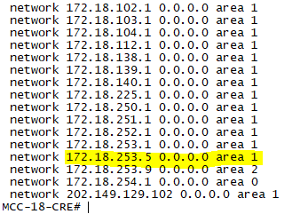
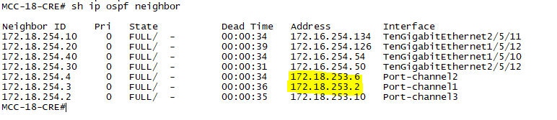
Lanjutan

Slide 8
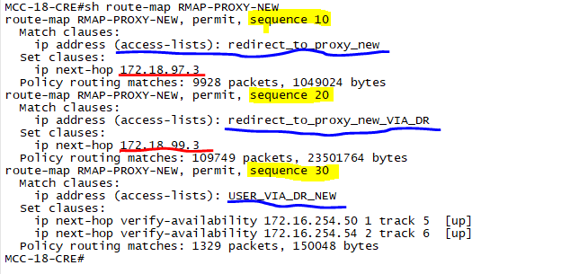
Lanjutan

Slide 9
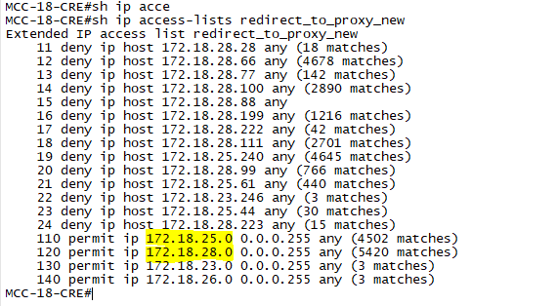
Lanjutan

Slide 10
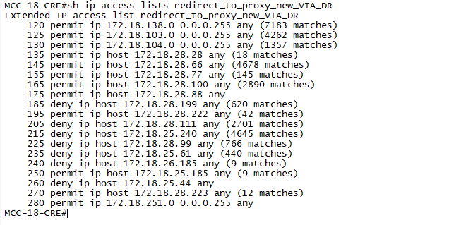
Lanjutan

Slide 11

Lanjutan

Slide 12
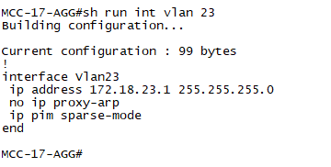
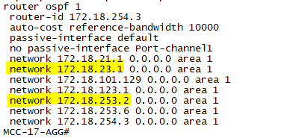
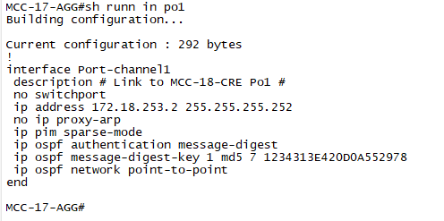
17th Floor Network Breakdown

Slide 13
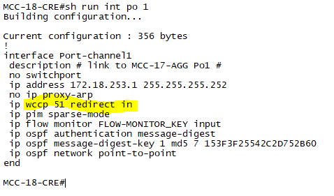
Lanjutan

Slide 14
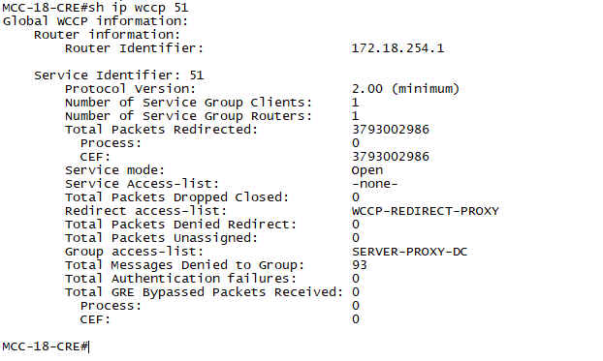
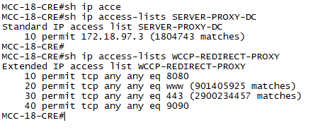
Lanjutan

Slide 15

Thanks

Slide 16
Summary
Pembahasan Segment VLAN & Gateway lantai 18 & 17
Pembahasan Policy Base Routing untuk jalur segment lt 18
Pembahasan OSPF Routing HO-DC-DRC
Pembahasan WCCP jalur segment lt 17

